Slide 1
LLDET
A
Automated Liquid Level Detection

Slide 2





Team Members
Jesse Tutor - CPE
Zach Fauver - CPE
JR Ladd - EE
Khara Robinson - CPE
Andrew Bullington - EE

Slide 3

Introduction: Faculty Advisor
Assistant professor at Mississippi State University
Ph.D., Engineering Education, Virginia Tech, 2013
Undergraduate Engineering Education, Educational Data Mining, Scientific Visualization, Digital Image Processing
Dr. Jean Mohammadi-Aragh

Slide 4
Outline
Problem & Solution
Constraints
Evaluation
Timeline

Slide 5
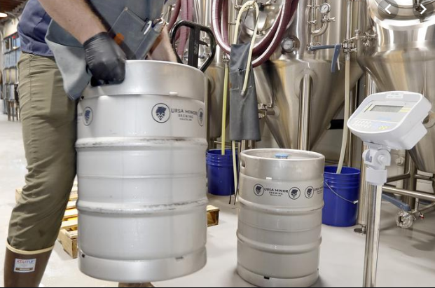
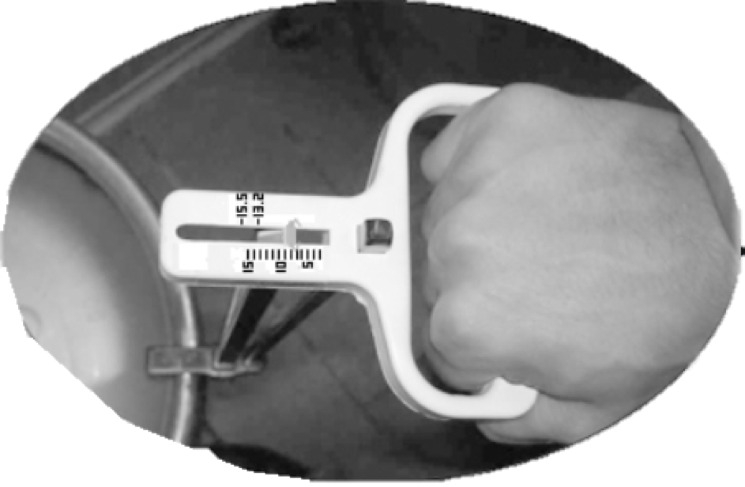

Problem Statement
Lack of convenient way to measure the liquid in a metal container
[1]
[3]
[2]

Slide 6
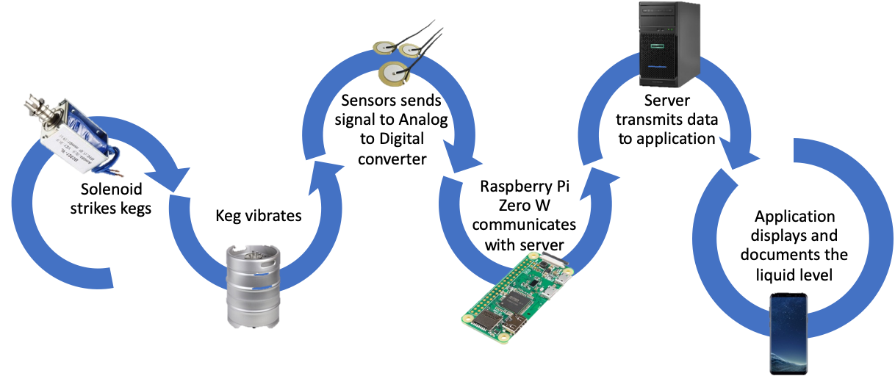
Solution Overview

Slide 7
Constraints
Practical
Technical

Slide 8

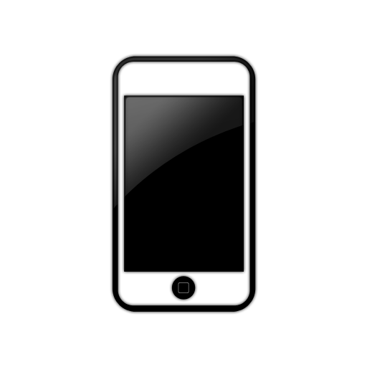

Practical Constraints
ECONOMIC
Cost less than $200
SOCIAL
Application use for liquid-level tracking
SUSTAINABILITY
Hands-free operation

Slide 9



Technical Constraints
ACCURACY
±5% of actual amount
BATTERY LIFE
16 hours continuous time
WIRELESS TRANSMISSION
9 meters range connection

Slide 10
Engineering Standards
Specific Standard | Standard Document | Specification/Application
IP52 | IP Rating Chart (IEC 60529) | Protects from water spray less than 15 degrees from vertical
IEEE 802.11N | WiFi Basic Specification | Used for sending and receiving data from the host device and a smartphone, compatible with the Raspberry Pi

Slide 11
Subsystem Tests
Wireless Testing
Accuracy Testing
Interference Testing
Temperature Testing
Battery Testing

Slide 12
Wireless Testing
Distance (meter) | Signal Strength (dBm) | Link Quality
3 meters | -51 | 59/70
6 meters | -53 | 57/70
9 meters | -63 | 47/70
12 meters | -75 | 35/70
Table 4.3.1 - Transmission Tests

Slide 13
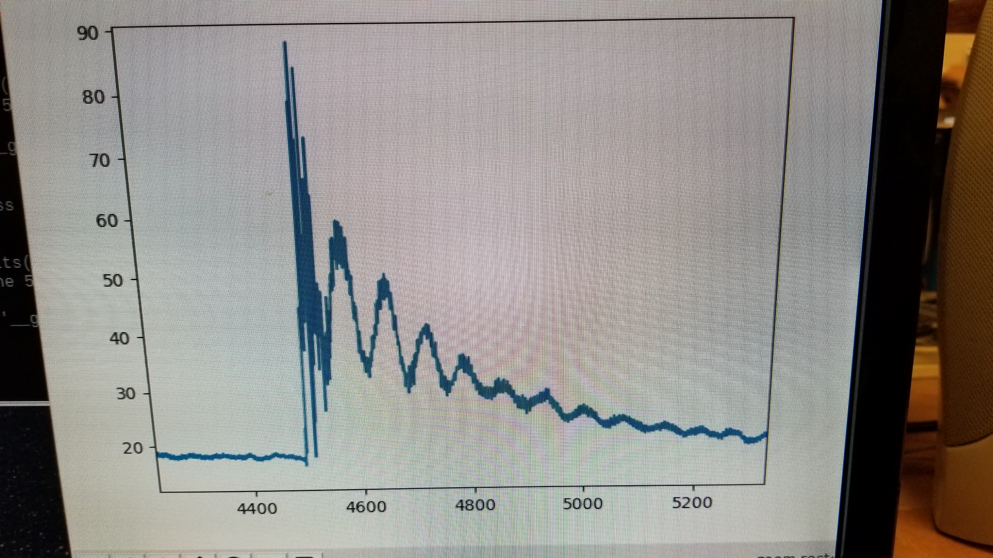
Accuracy Testing
Actual Value | Recorded Value
0% | N/A
25% (4.875 L) | N/A
50% (9.75 L) | N/A
75% (4.625 L) | N/A
100% (19.5 L) | N/A
∝V
ms
Table 4.2.1 - Accuracy Tests

Slide 14
Interference Testing
Volume in dB | Expected Result | Actual Result | % Error
20 dB | N/A | N/A | N/A
40 dB | N/A | N/A | N/A
60 dB | N/A | N/A | N/A
80 dB | N/A | N/A | N/A
Table 4.5.1 - Interference Tests

Slide 15
Temperature Tests
Temperature | Expected Result | Actual Result | % Error
32°C | N/A | N/A | N/A
20°C | N/A | N/A | N/A
10°C | N/A | N/A | N/A
0°C | N/A | N/A | N/A
Table 4.1.1 - Temperature Tests

Slide 16
Battery Tests
Temperature | 16 Hour Lifetime Y/N | Percentage Left (%)
32°C | N/A | N/A
20°C | N/A | N/A
10°C | N/A | N/A
0°C | N/A | N/A
Table 4.4.2 - Battery Tests

Slide 17
System Testing

Slide 18
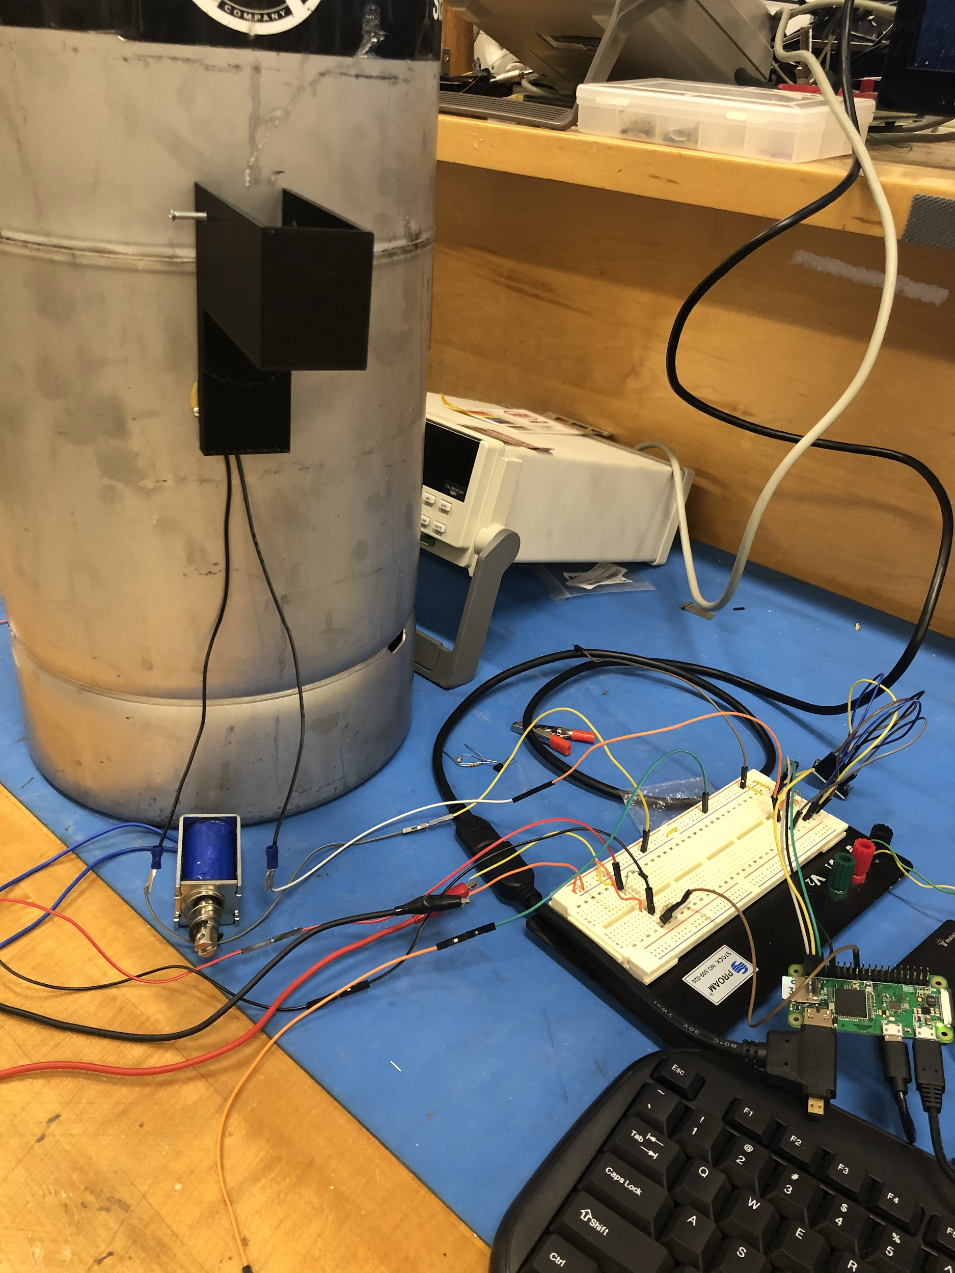
System Tests
Solenoid Activated by Raspberry Pi | Y/N
Resonance Captured by Sensors with <5% Error | % Error
Transmission to Server Successful | Y/N
Transmission to App Successful | Y/N
Table 4.4.3 - System Tests

Slide 19
Progress and Timeline
August
September
October
November
December
Design Demo
System Integration Testing
Subsystem Design Parts Order
Design Overview
Problem Research

Slide 20
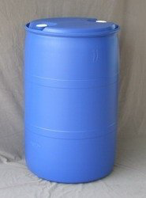
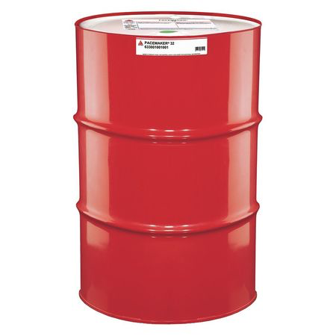
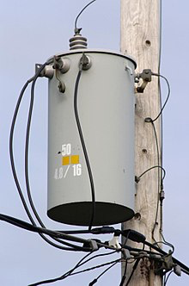
Future Development
Different applications possible
​Chemical containers
Oil drums
Transformers
[17]
[18]
[19]

Slide 21
Questions?
LLDET
A

Slide 22
References
[1] "Ursa Minor Brewing brings more beer, pizza to Lincoln Park | Duluth News Tribune." duluthnewstribune.com. https://www.duluthnewstribune.com/business/4513545-ursa-minor-brewing-brings-more-beer-pizza-lincoln-park (accessed Oct. 22, 2019).
[2] "On the Virtue of a Bent Finger: A Challenge for the Days of Awe | ReformJudiasm.org." reformjudiasm.org. https://reformjudaism.org/blog/2017/09/14/virtue-bent-finger-challenge-days-awe (accessed Oct. 22, 2019).
[3] “Keg Scale.” alcoholcontrols.com. https://alcoholcontrols.com/noname.html (accessed Sept. 3, 2019).
[17] "Chemical Container - Buy Chemical Container Product on Alibaba.com." alibaba.com. https://www.alibaba.com/product-detail/chemical-container_245873792.html (accessed Oct. 22, 2019).
[18] "Citgo Hydraulic Oil, Mineral Oil, 68 cSt, 55 gal. 633493001001 | Zoro.com." zoro.com. https://www.zoro.com/citgo-hydraulic-oil-mineral-oil-68-cst-55-gal-633493001001/i/G2209947/ (accessed Oct. 22, 2019).
[19] Mack, James E.; Shoemaker, Thomas (2006). "Chapter 15 - Distribution Transformers" (PDF). The Lineman's and Cableman's Handbook (11th ed.). New York: McGraw-Hill. pp. 15–1 to 15–22. ISBN 0-07-146789-0. Archived from the original (PDF) on 2013-02-10. Retrieved 2013-01-12

